Slide 1
Recent seismological and strong-motion studies in Iran and selection of Tehran as a supersite
Mehdi ZARE
Professor of IIEES;
Advisor to BHRC;
Associate Member of the Academy of Sciences of Iran;
Email: mzare@iiees.ac.ir
Academy of sciences, IR. IRAN

Slide 2
Seismic and Strong Motion Networks of Iran
Academy of sciences, IR. IRAN

Slide 3
Networks in Iran
Seismographic Networks in Iran:
Iranian Seismological Center (IRSC)
By Institute of Geophysics, University of Tehran
National Broadband Seismic Network of Iran
By International Institute of Earthquake Engineering and Seismology (IIEES)
Strong motion networks in Iran:
Iran Strong Motion Network (ISMN)
By Road , Housing & Urban Development Research Center
Strong Motion Network for Tehran Early Warning System
By Tehran Disaster Mitigation and Management Organization
Academy of sciences, IR. IRAN

Slide 4
Iranian Seismological Center (IRSC)
Academy of sciences, IR. IRAN

Slide 5
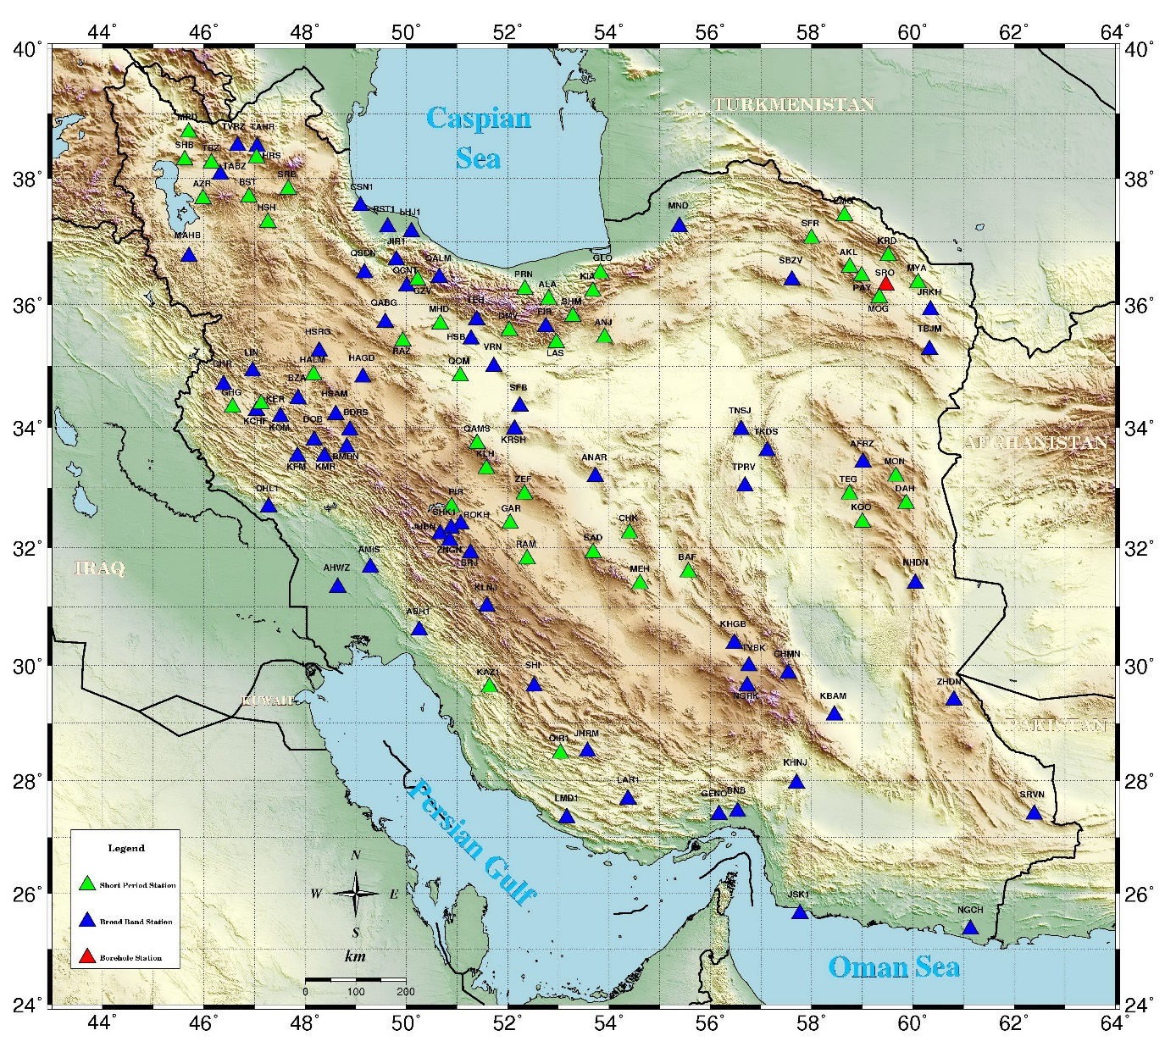
Current Status of IRSC
108 digital seismic stations
20 seismic local networks
4 digital seismic stations
1 borehole stations
Academy of sciences, IR. IRAN

Slide 6
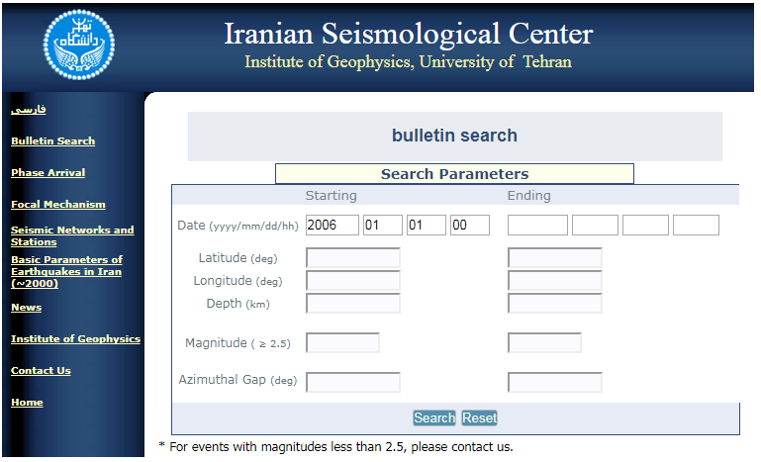
IRSC Bulletin Search
http://irsc.ut.ac.ir/bulletin.php
Academy of sciences, IR. IRAN

Slide 7
Highlights about IRSC in 2017
Setting up a research luminescence dating laboratory;
Online earthquake reports to people via social networks (Telegram app);
Setting up three new seismic stations in NW of Iran (since May 18, 2017);
No. of available data (2006/01/01 – 2017/10/23; Mw>2.5)= 32,000
No. of records in 2017 (Jan 01 – Oct 23)= 2,590
Online data exchange system between IRSC and IIEES since May 22, 2017
Academy of sciences, IR. IRAN

Slide 8
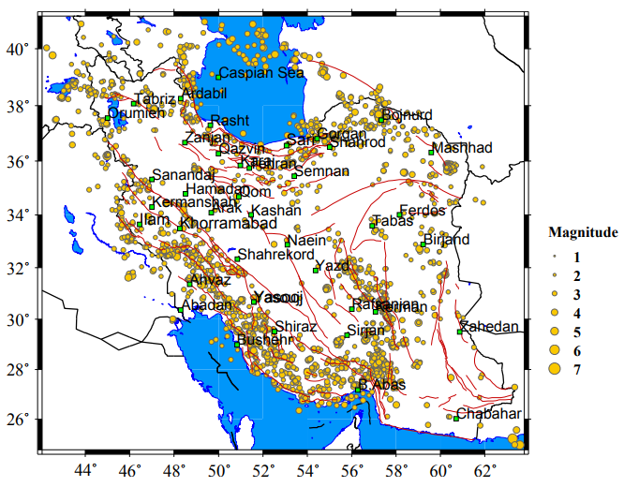
Iranian Seismological Center (IRSC)
Records in 2017 (Jan 01 – Oct 23)
Academy of sciences, IR. IRAN

Slide 9
National Center of Broadband Seismic Network of Iran (IIEES)
Academy of sciences, IR. IRAN

Slide 10
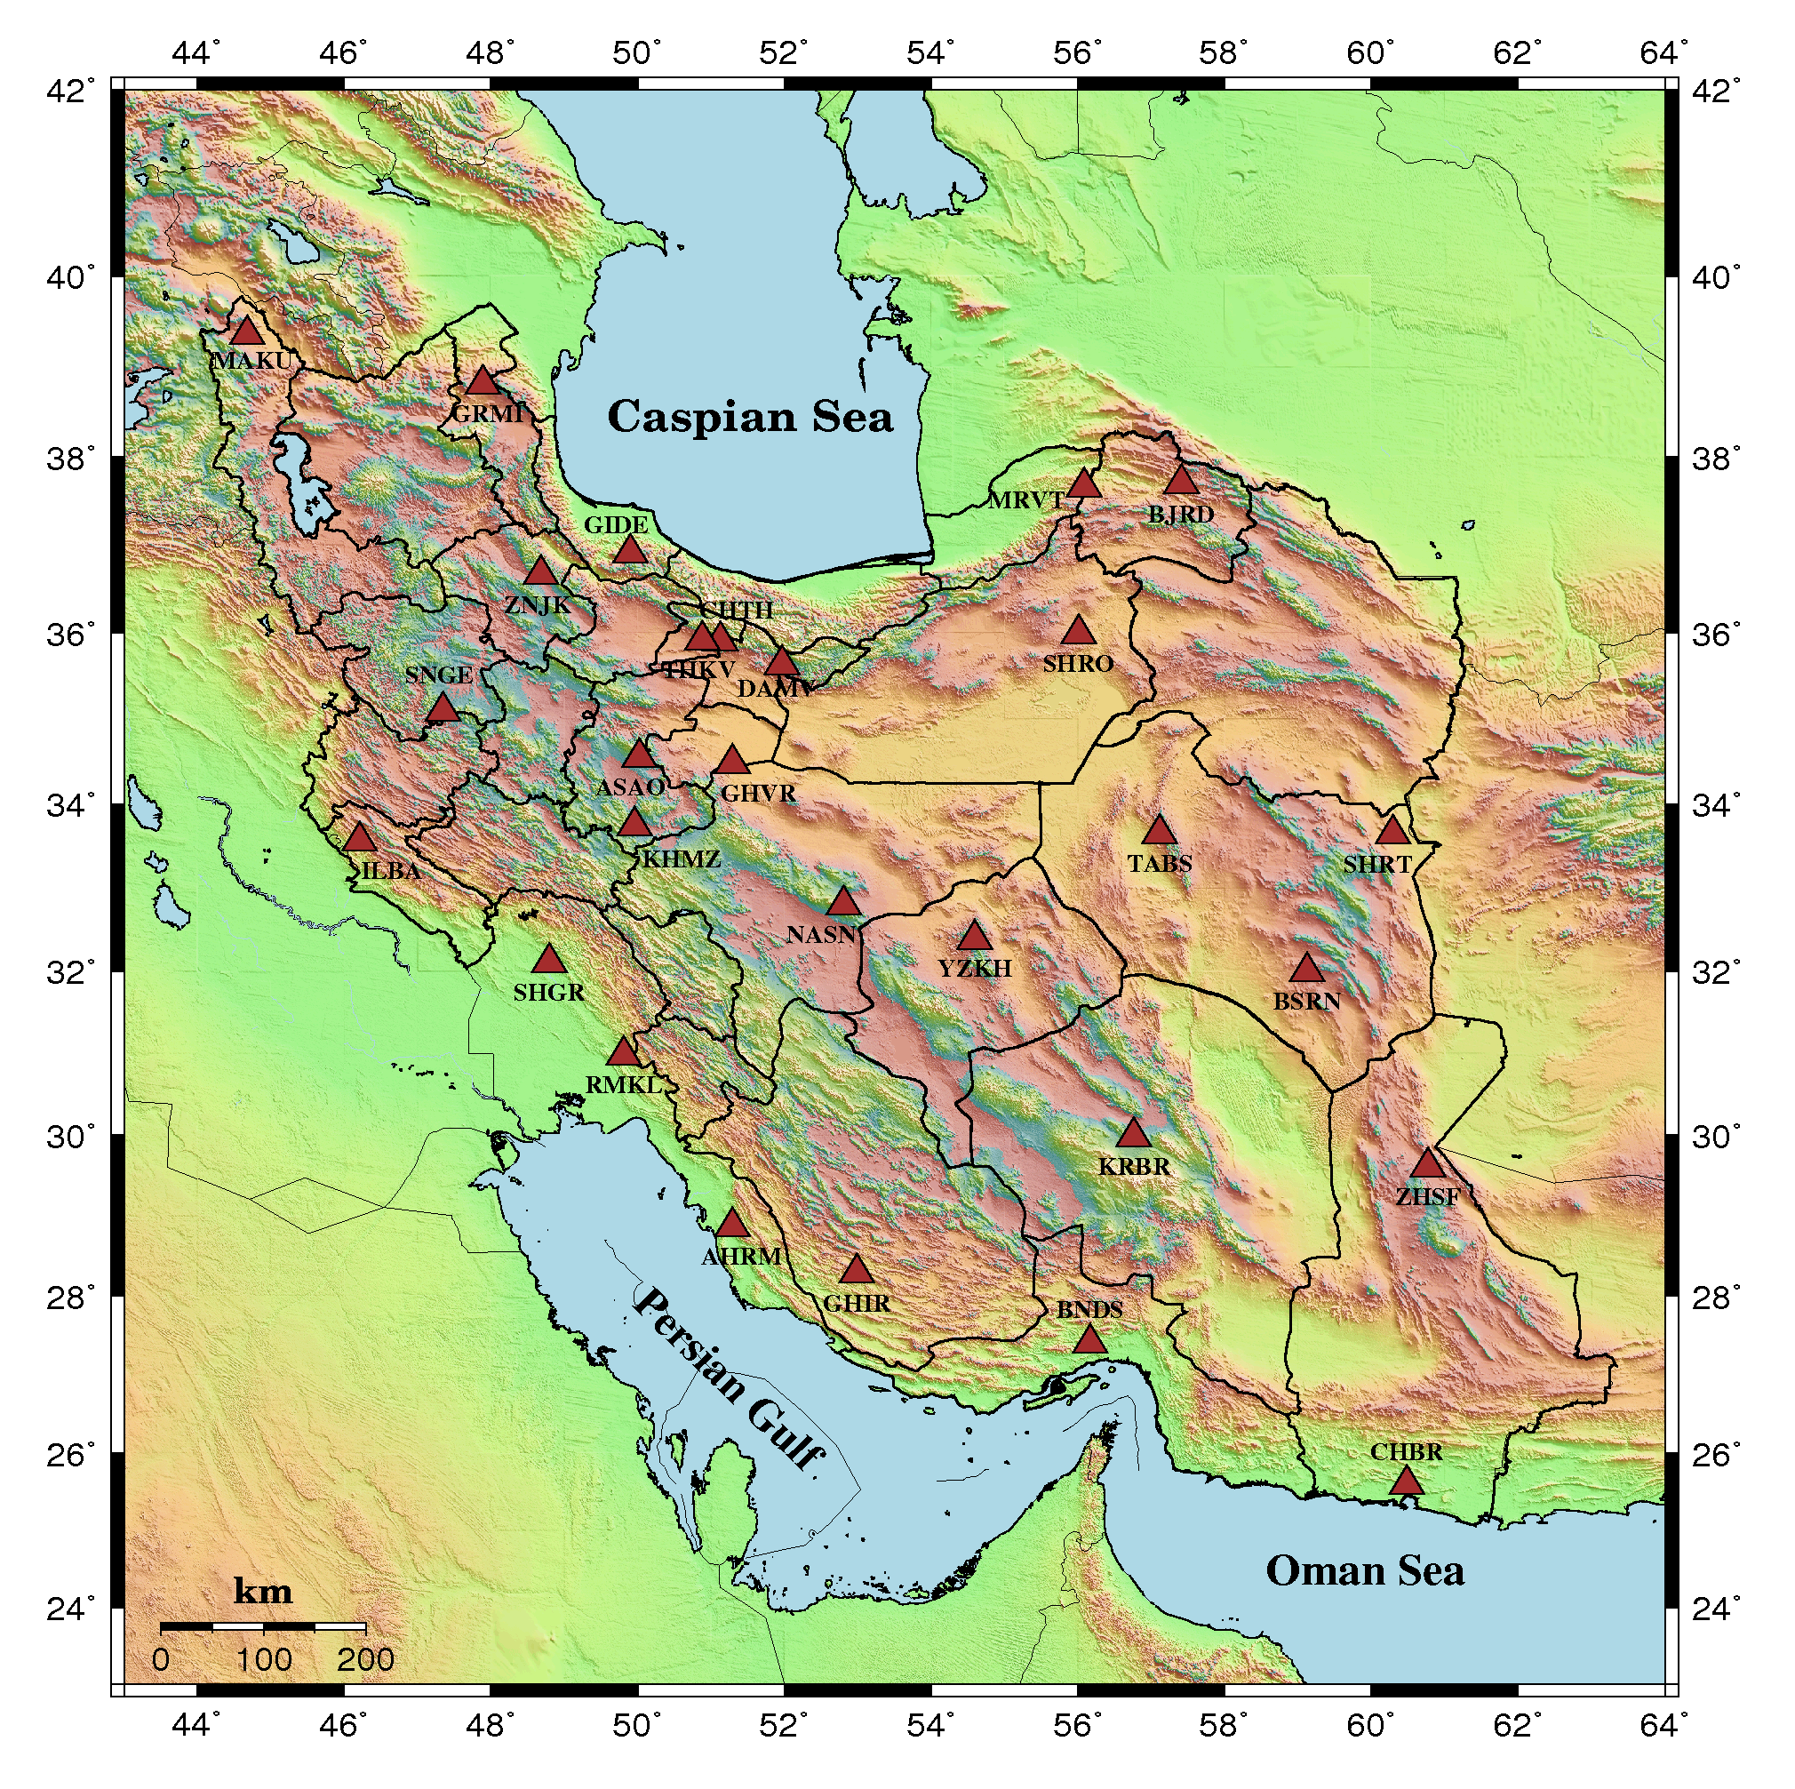
Current Status of IIEES network
No. of seismic stations =25
All available records (1900 to Oct 2017)= 26,260
No. of records in 2017 (Jan to Oct 23)= 1,265
Seismic data from stations has been collected in the network center in Tehran by satellite communication system.
Academy of sciences, IR. IRAN

Slide 11
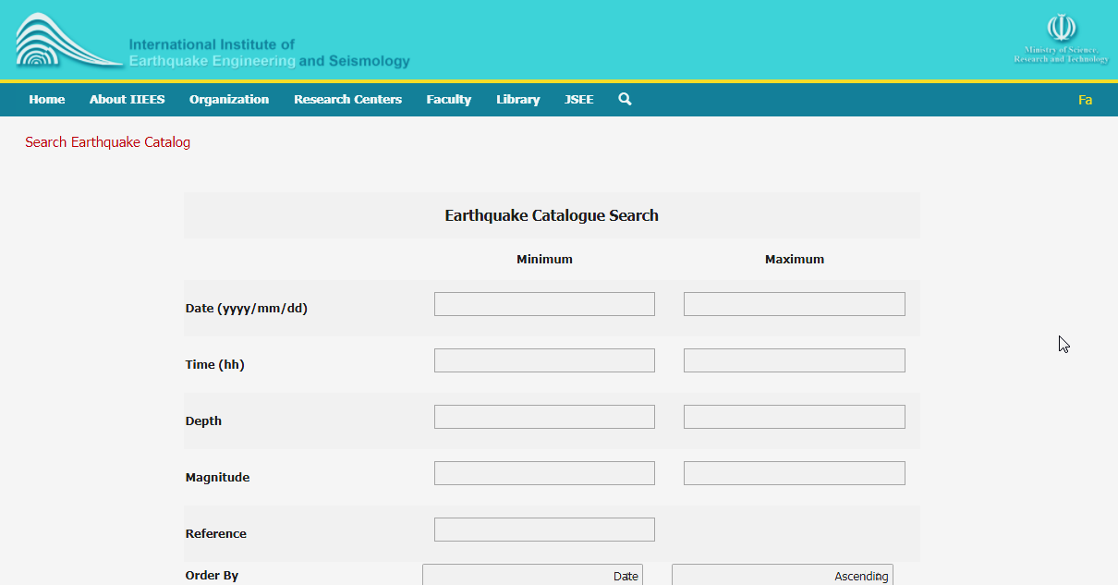
IIEES Bulletin Search
http://www.iiees.ac.ir/en/eqcatalog/
Academy of sciences, IR. IRAN

Slide 12
Highlights about IIEES in 2017
Setting up a new broadband station in Ilam (since Dec, 2016);
Online access to earthquake waveforms for academic members
Comprehensive study of the earthquake and tsunami hazard in the Makran subduction zone in Iran (since September 2017)
- joint research between IIEES and GFZ;
- Installation of 930 seismic geophones;
- Three N-S profiles with 250 km length
- 120 boreholes
- study of depths
Academy of sciences, IR. IRAN

Slide 13
Uniform Seismic Catalogs
Seismicity Catalogs:
Middle-East; 1250 B.C.-2006; 4≤M_{w} (Zare et al., 2014)
Iran; 3rd millennium BC-2010; 3.5≤M_{w} (Karimiparidari et al., 2013)
Iran; 1900-2011; 4≤M_{w} (Shahvar et al., 2013)
Intensity catalogs:
Iran; 300 B.C.-2015; IV≤I_{max} (Amini et al., 2016)
Iran; 1975-2000; II≤I (Zare and Memarian, 2002)
IIEES

Slide 14
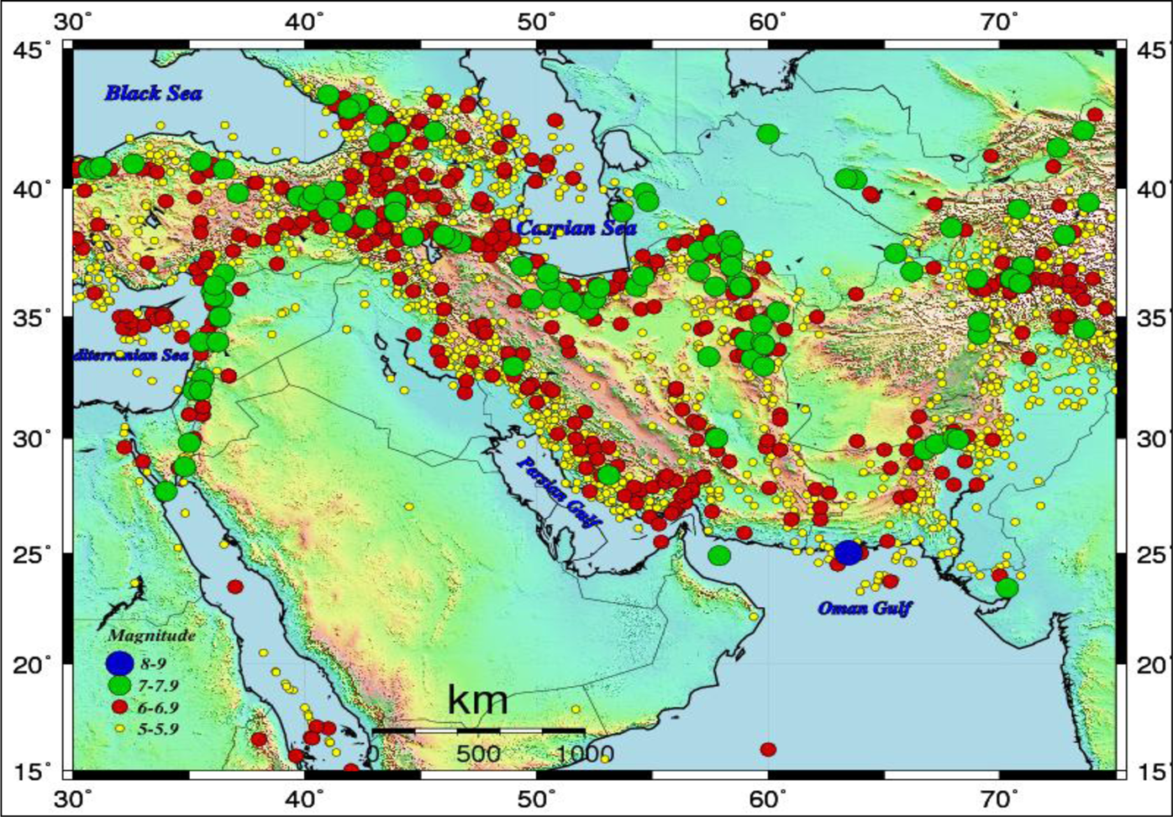
Uniform Seismic Catalogs
Recent developments of the Middle-East catalog (Zaré et al., 2014):
IIEES

Slide 15
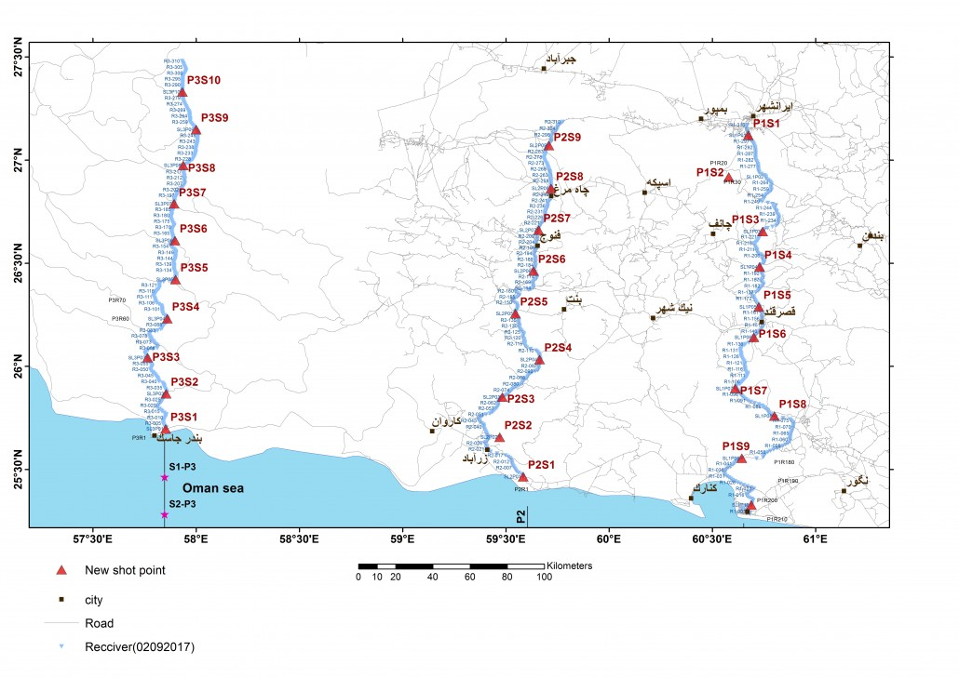
Earthquake and tsunami hazard in the Makran subduction zone
Three N-S profiles
Academy of sciences, IR. IRAN

Slide 16
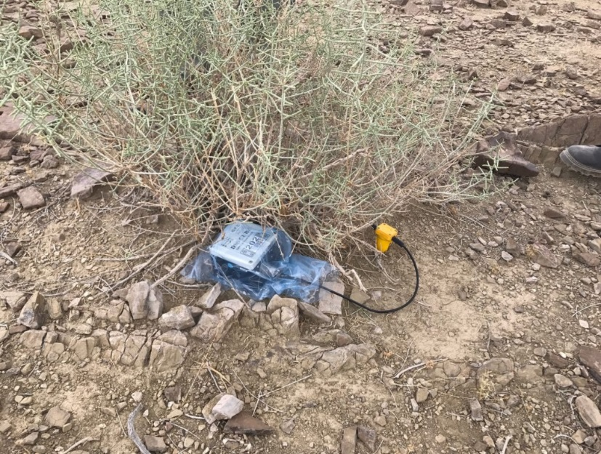
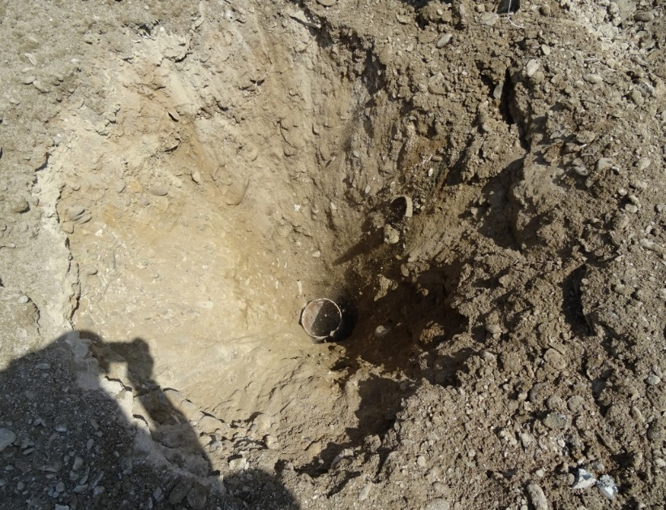
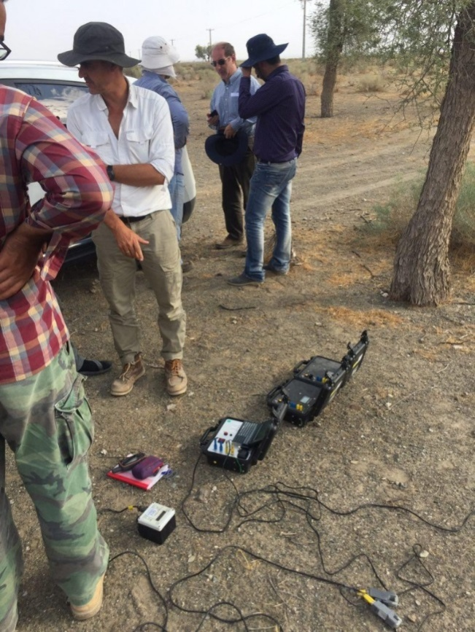
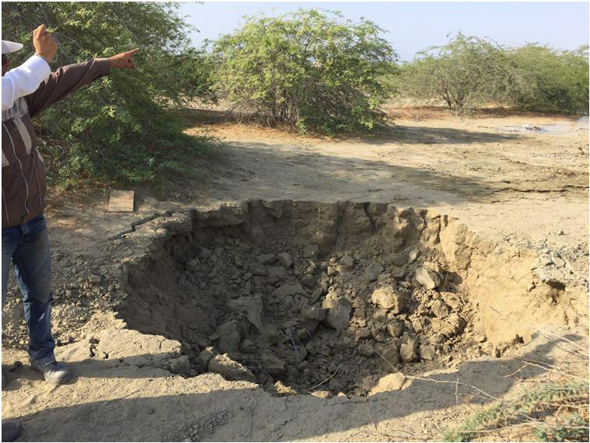
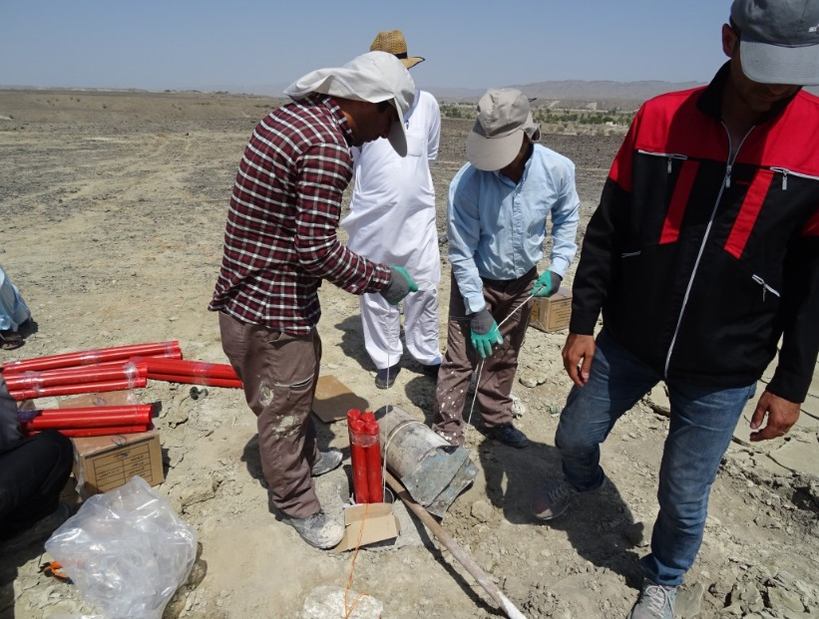
Earthquake and tsunami hazard in the Makran subduction zone
Academy of sciences, IR. IRAN

Slide 17
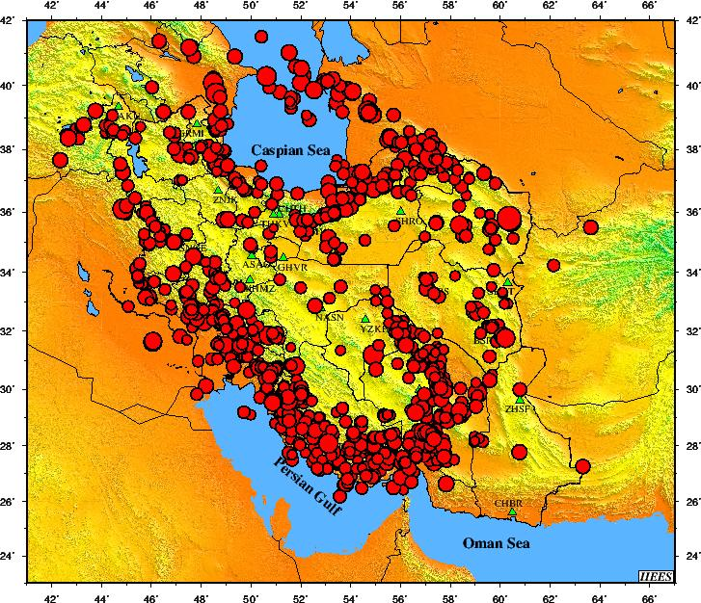
Broadband Seismic Network (IIEES)
Records in 2017 (Jan 01 – Oct 23)
= 1,265 data
Academy of sciences, IR. IRAN

Slide 18
Iran Strong Motion Network (ISMN)
Academy of sciences, IR. IRAN

Slide 19
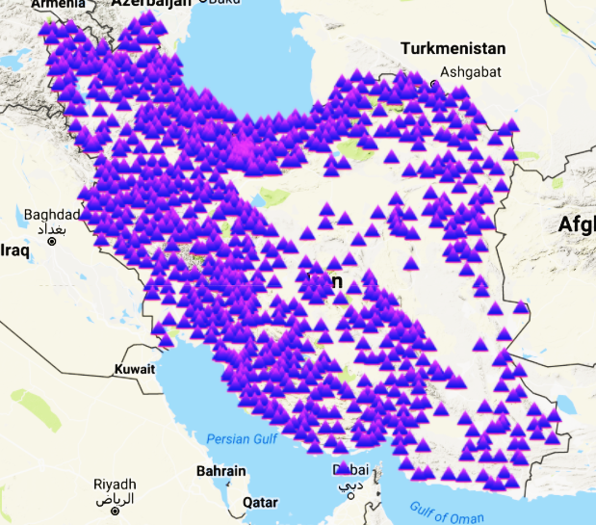
Current Status of ISMN network
1055 active stations
- SSA-2: 1021
- CMG5TD: 49
- Free field stations: 631
- Instruments at dams: 65
- Downhole arrays: 4
- 1 tall buildings
All available records (1973/12/16 to 2017/10/23)= 11,480
No. of records in 2017 (Jan to Oct 23)= 408
Academy of sciences, IR. IRAN

Slide 20
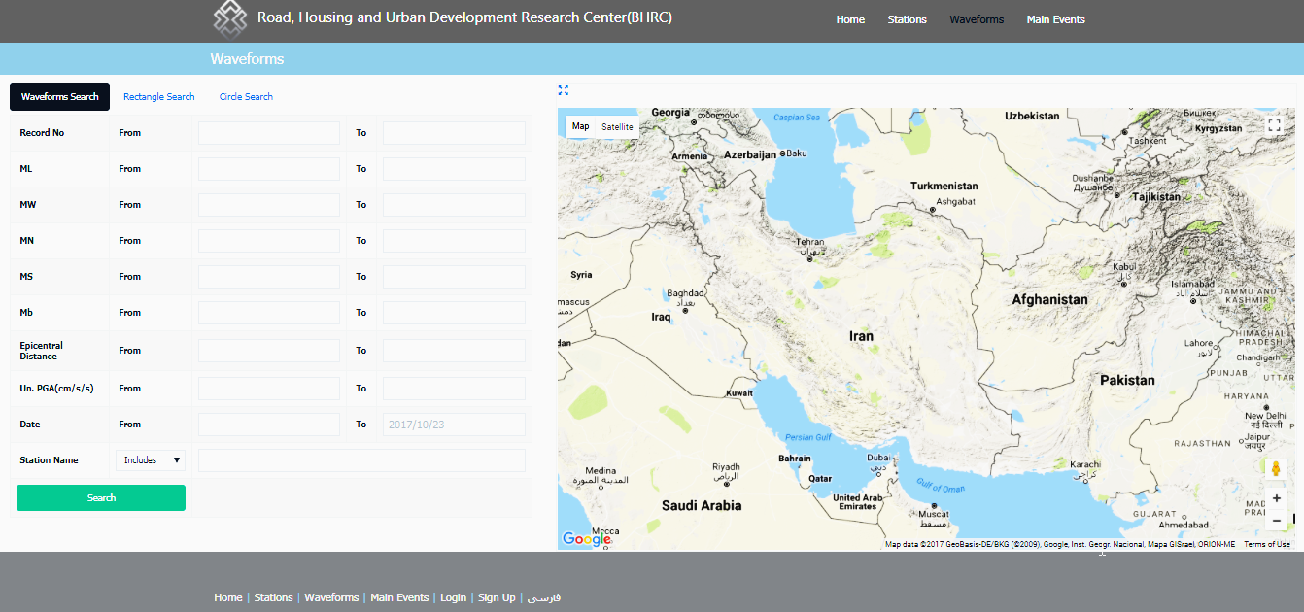
ISMN Bulletin Search
Accelerogram Search
http://smd.bhrc.ac.ir/Portal/en/Search/Waveforms
Academy of sciences, IR. IRAN

Slide 21
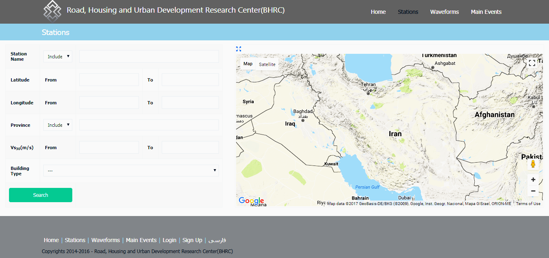
ISMN Bulletin Search
Station Search
http://smd.bhrc.ac.ir/Portal/en/Search/Stations
Academy of sciences, IR. IRAN

Slide 22
Highlights about ISMN in 2017
Corporation and joint seminar about “Recent findings of the Iran Strong Motion Network (ISMN) and new achievements in seismic hazard analysis” between Pacific Earthquake Engineering Research Center (PEER) and Road, Housing and Development Research Center of Iran (BHRC)
Online access to 50 waveforms for academic members
Academy of sciences, IR. IRAN

Slide 23
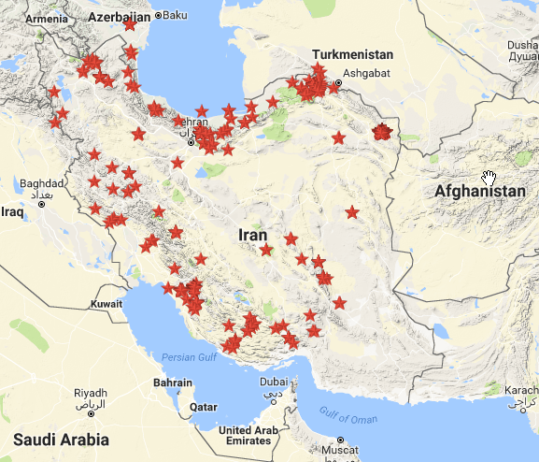
Iran Strong Motion Network (ISMN)
Records in 2017 (Jan 01 – Oct 23)
= 408 data
Academy of sciences, IR. IRAN

Slide 24
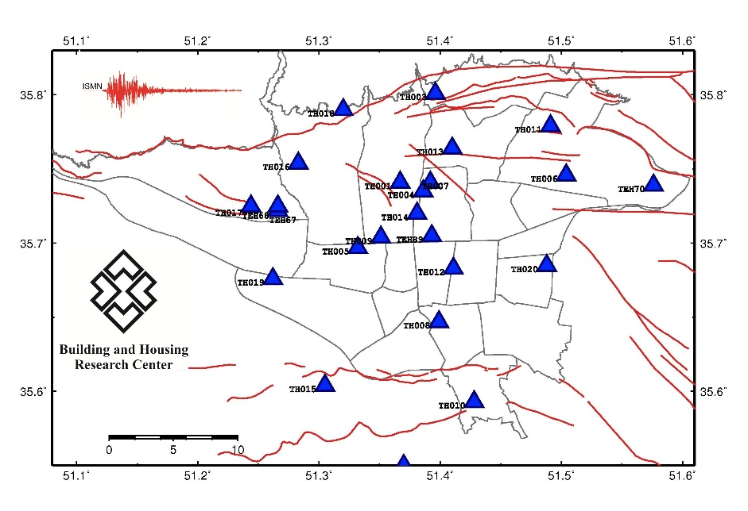
First steps to set up a rapid response system for Tehran(TRRNet)
In 2011 a pilot project was started in ISMN for establishing a rapid response system for Tehran.
Tehran Rapid Response Network (TRRNet) is composed of 20 three-component strong-motion stations installed in free-field sites.
All 20 stations in the TRRNet are connected to a data center using an Internet Protocol/Multi-Protocol Label Switching (IP/MPLS)
Map of Tehran rapid response system, phase 1
Academy of sciences, IR. IRAN

Slide 25
Recent Studies
Academy of sciences, IR. IRAN

Slide 26
Near-field strong motion analysis
Number of strong motion records in the ISMN (2004 - Oct of 2017)= 7,190
140 Processed and analyzed accelerograms corresponding to 9 earthquakes (5.5<Mw) and 8 recent near-field records
Results of processing of recent near-field records with epicentral distance< 20 km and Mw> 6
Academy of sciences, IR. IRAN

Slide 27
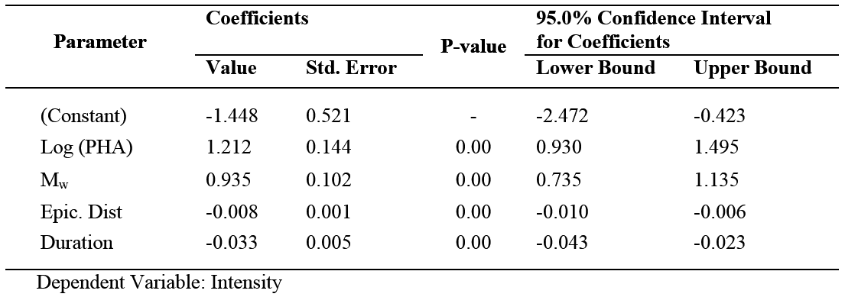
Strong motion- intensity prediction equations
Development of conversion relationships between the values of "intensity" and ground motion parameters e.g. "PGA", "Mw", "epicentral distance", "site type", and "duration" using a multiple stepwise regression
Coefficients of GMPs-intensity equation in the stepwise regression
Academy of sciences, IR. IRAN

Slide 28
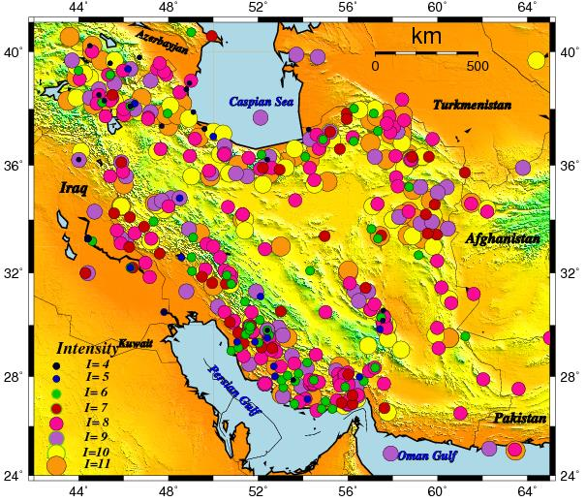
Catalogue of the earthquakes with maximum intensities
dataset including all available intensity information with homogeneous maximum intensities IV to XI for 512 earthquakes 658 AD to 2013 /
Mw of 4.1 to 8.1.
Map of intensity catalogue of Iran with 512 earthquakes
Academy of sciences, IR. IRAN

Slide 29
Relationships between different earthquake intensity scales
Development of relationships between different reported intensity scales in Iran (e.g. AMS, MSK, MMI, EMS and ESI) based on intensity catalog and Orthogonal regression and development of a new re-estimated intensity scale called EMS-ESI scale
Averages of intensities in AMS, MMI, EMS and MSK scales against the EMS-ESI scale using only Imax (a) and MDPs (b).
Academy of sciences, IR. IRAN

Slide 30
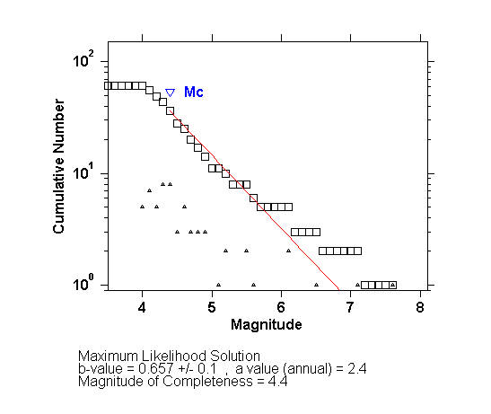
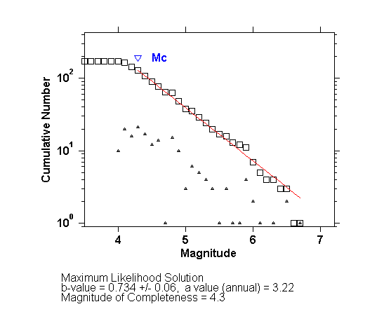
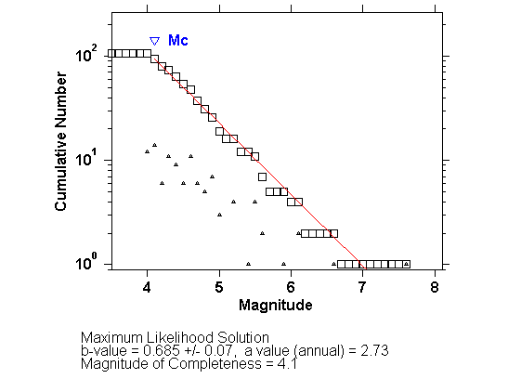
Relationships between different earthquake intensity scales
Academy of sciences, IR. IRAN

Slide 31
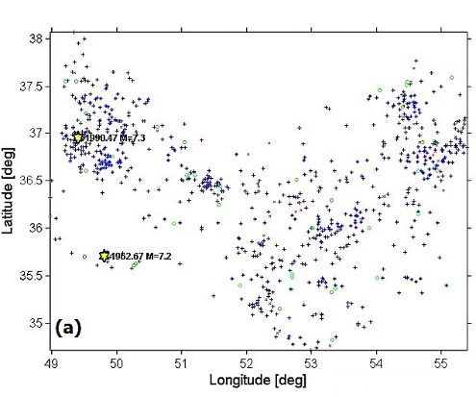
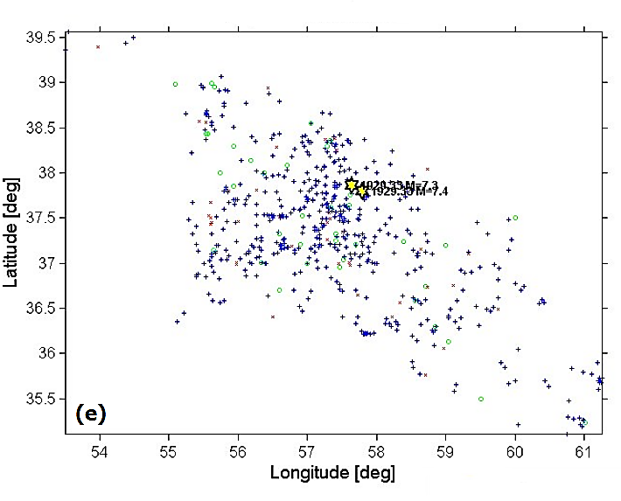
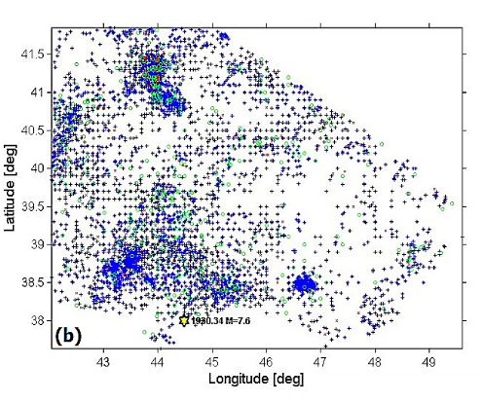
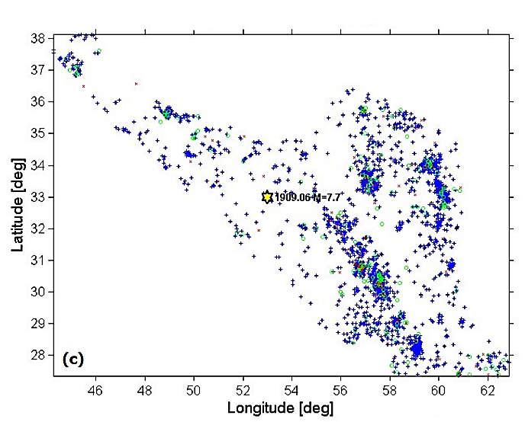
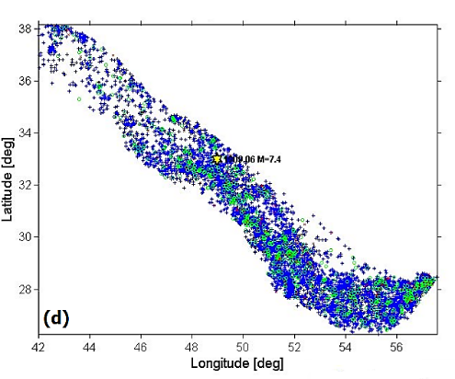
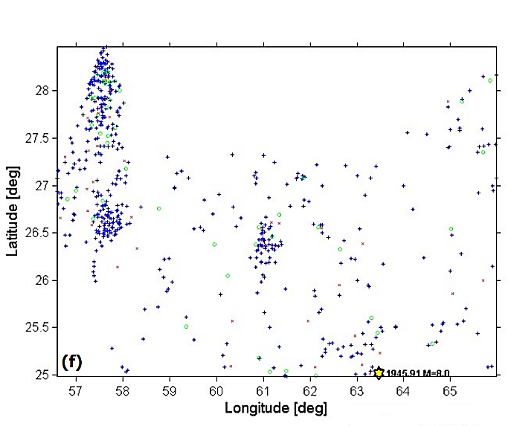

Slide 32
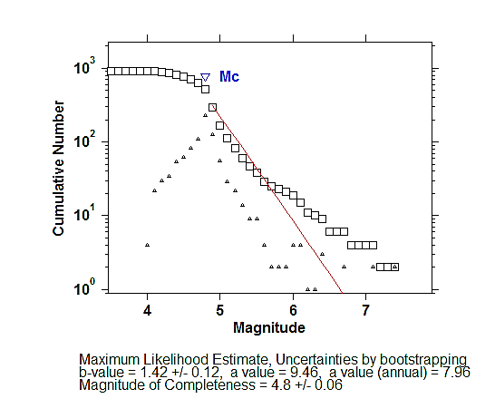
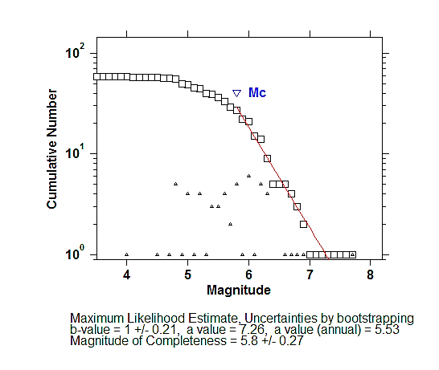
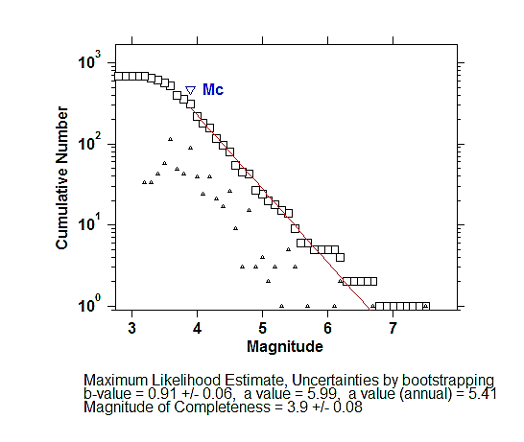
Level of completeness in Iranian Cataog

Slide 33
Zone | $$m_{0}$$ | Number | $$\overline{m}$$ | $b$-value | $$m_{max}$$ | Level of confidence $$\left(1−α_{c}\right)$$
Alborz | 4.8 | 112 | 5.16 | 1.19 | 7.3 | 0.11
 | 5.0 | 62 | 5.43 | 1.00 | 7.3 | 0.27
 | 5.5 | 20 | 6.04 | 0.80 | 7.3 | 0.52
Azerbaijan | 4.8 | 394 | 5.13 | 1.32 | 7.3 | 0.18
 | 5.0 | 229 | 5.33 | 1.29 | 7.3 | 0.22
 | 5.5 | 56 | 5.92 | 1.03 | 7.3 | 0.55
Kopeh Dagh | 4.8 | 117 | 5.18 | 1.15 | 7.2 | 0.18
 | 5.0 | 62 | 5.49 | 0.89 | 7.2 | 0.5
 | 5.5 | 24 | 6.02 | 0.83 | 7.2 | 0.61
Makran | 4.8 | 130 | 5.16 | 1.20 | 8.0 | 0.02
 | 5.0 | 71 | 5.40 | 1.00 | 8.0 | 0.07
 | 5.5 | 22 | 6.03 | 0.82 | 8.0 | 0.18
Central Iran | 4.8 | 282 | 5.24 | 0.98 | 7.4 | 0.55
 | 5.0 | 170 | 5.51 | 0.84 | 7.4 | 0.81
 | 5.5 | 69 | 6.06 | 0.77 | 7.4 | 0.91
Zagros | 4.8 | 771 | 5.13 | 1.30 | 6.9 | 0.76
 | 5.0 | 462 | 5.33 | 1.30 | 6.9 | 0.79
 | 5.5 | 133 | 5.82 | 1.36 | 6.9 | 0.81

Slide 34
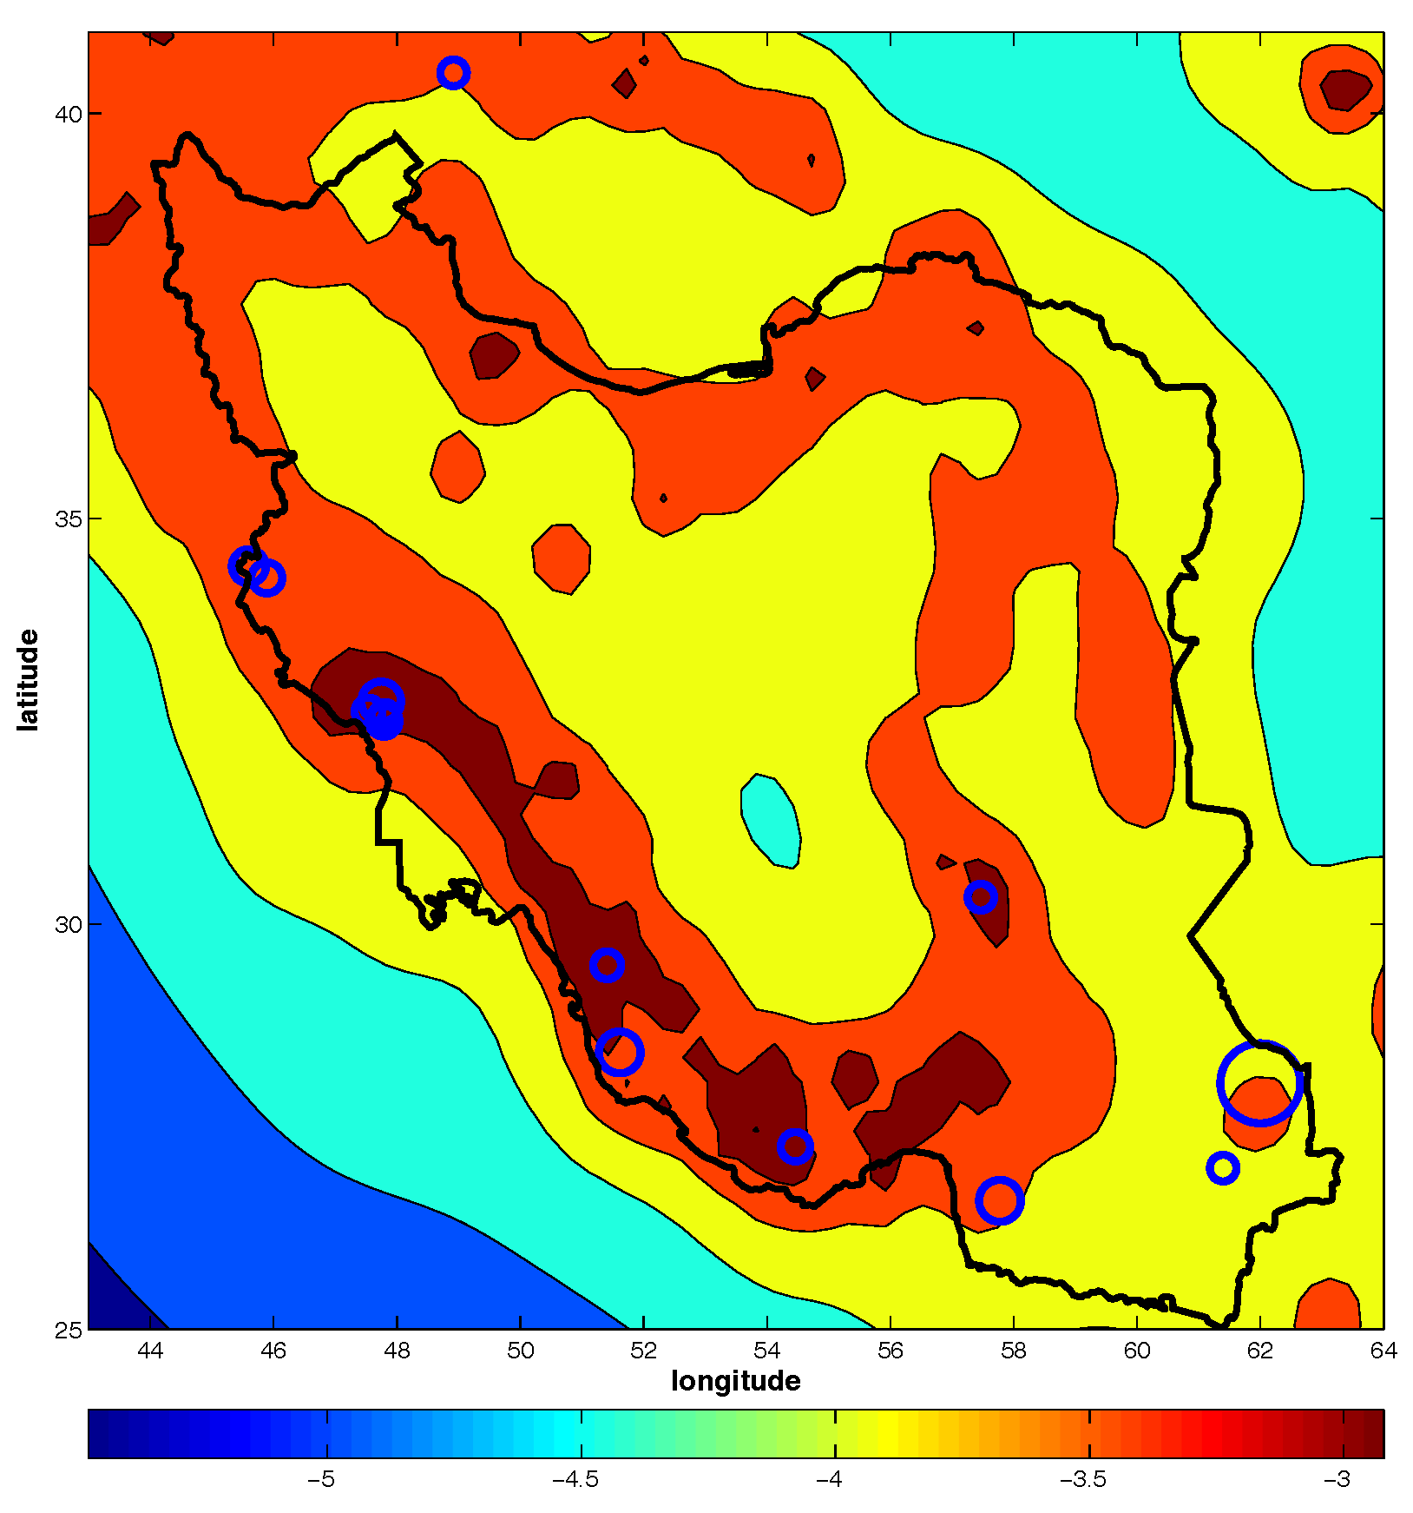
Probabilistic earthquake forecasts
The base 10 logarithm of expected number of earthquakes of m >5.5 over the five-year period from January 1, 2013 based on smoothing the locations of earthquakes of m >4.3 in the ISC catalog from 1980 to 2013.

Slide 36
Selection of Tehran as a permanent supersite
Tehran, with the high potential of several natural hazards, is proposed to be as a permanent supersite of Iran within framework of the GEO Geohazards Supersites and Natural Laboratories (GSNL) initiative.
Earthquake: historical events (Mw>7.5), major active faults and thick unconsolidated alluviums with site effects.
Flood: devastating floods in 1987 and 2015.
Subsidence: 36 cm annual subsidence in southwest plain of Tehran.
Landslide: old earthquake-triggered landslides.
Volcano: Damavand volcano eruption and stimulation of faults and triggering earthquake due to volcanic activities
Academy of sciences, IR. IRAN

Slide 37
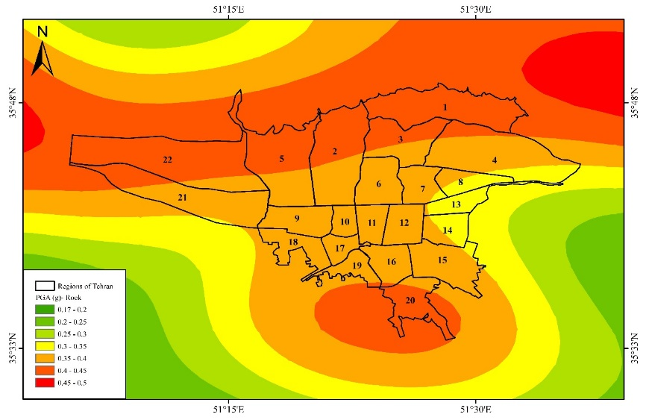
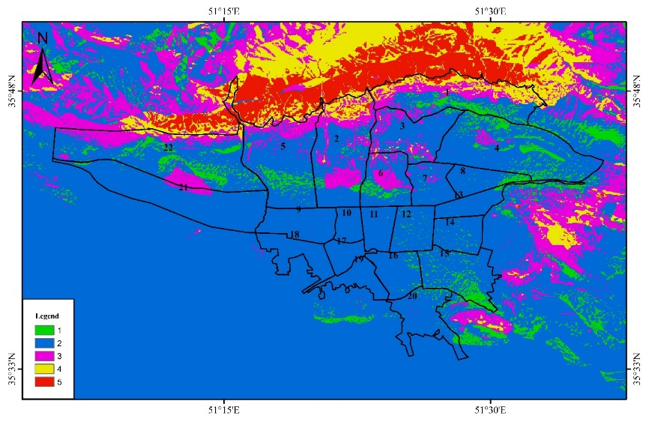
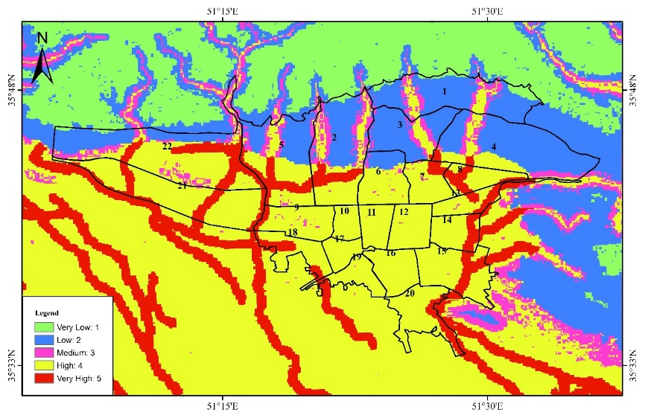
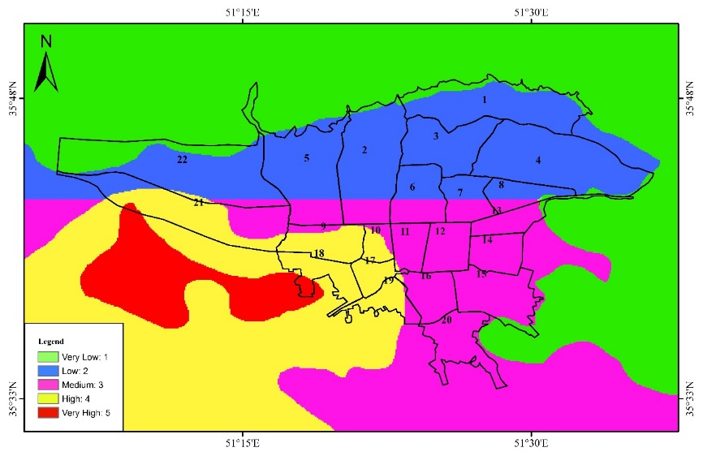
Selection of Tehran as a permanent supersite
Earthquake hazard map
Landslide hazard map
Flood hazard map
Subsidence hazard map
Academy of sciences, IR. IRAN

Slide 38
Selection of Tehran as a permanent supersite
Open access to shareable databases of Tehran as a supersite:
Spaceborne and in-situ geophysical data
Seismicity and strong motion records
Geological maps (topography, formations, faults, …)
Airborne images and satellite data (GNSS, GPS, InSAR, LIDAR
Academy of sciences, IR. IRAN

Slide 39
Thank you for your attention
Academy of sciences, IR. IRAN

